Slide 1

Overcoming challenges in vitamin A intake modelling
Marjolein de Jong
Dutch National Institute for Public Health and the Environment (RIVM)

Slide 2
Disclosures
The present study was funded by the Netherlands Ministry of Health, Welfare and Sports. The funders had no role in the design of the study; in the collection, analyses, or interpretation of data
No conflict of interest

Slide 3
Vitamin A
Involved in various functions in the body, including:
Vision (especially adapting to low light)
Immune system function
Skin health and cell production
Fat soluble vitamin
Stored in the liver in both humans and animals

Slide 4
Vitamin A sources
Two forms of vitamin A in foods:
Retinol (animal source)
Carotenoids (provitamin A; plant source)
1 µg Retinol Activity Equivalent (RAE) =
1 µg retinol
12 µg beta-carotene
24 µg alpha-carotene
24 µg beta-cryptoxanthin
Vitamin A-rich foods:
Foods | µg RAE/100 g
Animal-based
Liver | 36,888
Liverproducts | Up to 7,980
Eel | 3,300
Plant-based
Dried seaweed | 1,624
Carrots | 1,074
Estimated Average Requirement (EAR) in NL:
Men: 615 µg RAE/day
Women: 530 µg RAE/day

Slide 5

Interest in habitual vitamin A intake
Food consumption data mostly available from a limited number of days
For example 24-h recalls or food records
Long term intake necessary for comparison to reference values
To assess risk of vitamin A inadequacy or excessive intakes
Therefore, use of program to calculate habitual intake from few short-term data collections
For example SPADE ¹
Correction for within-person variation
¹ Dekkers, A. L., et al. (2014). SPADE, a new statistical program to estimate habitual dietary intake from multiple food sources and dietary supplements. The Journal of nutrition, 144(12), 2083-2091.

Slide 6
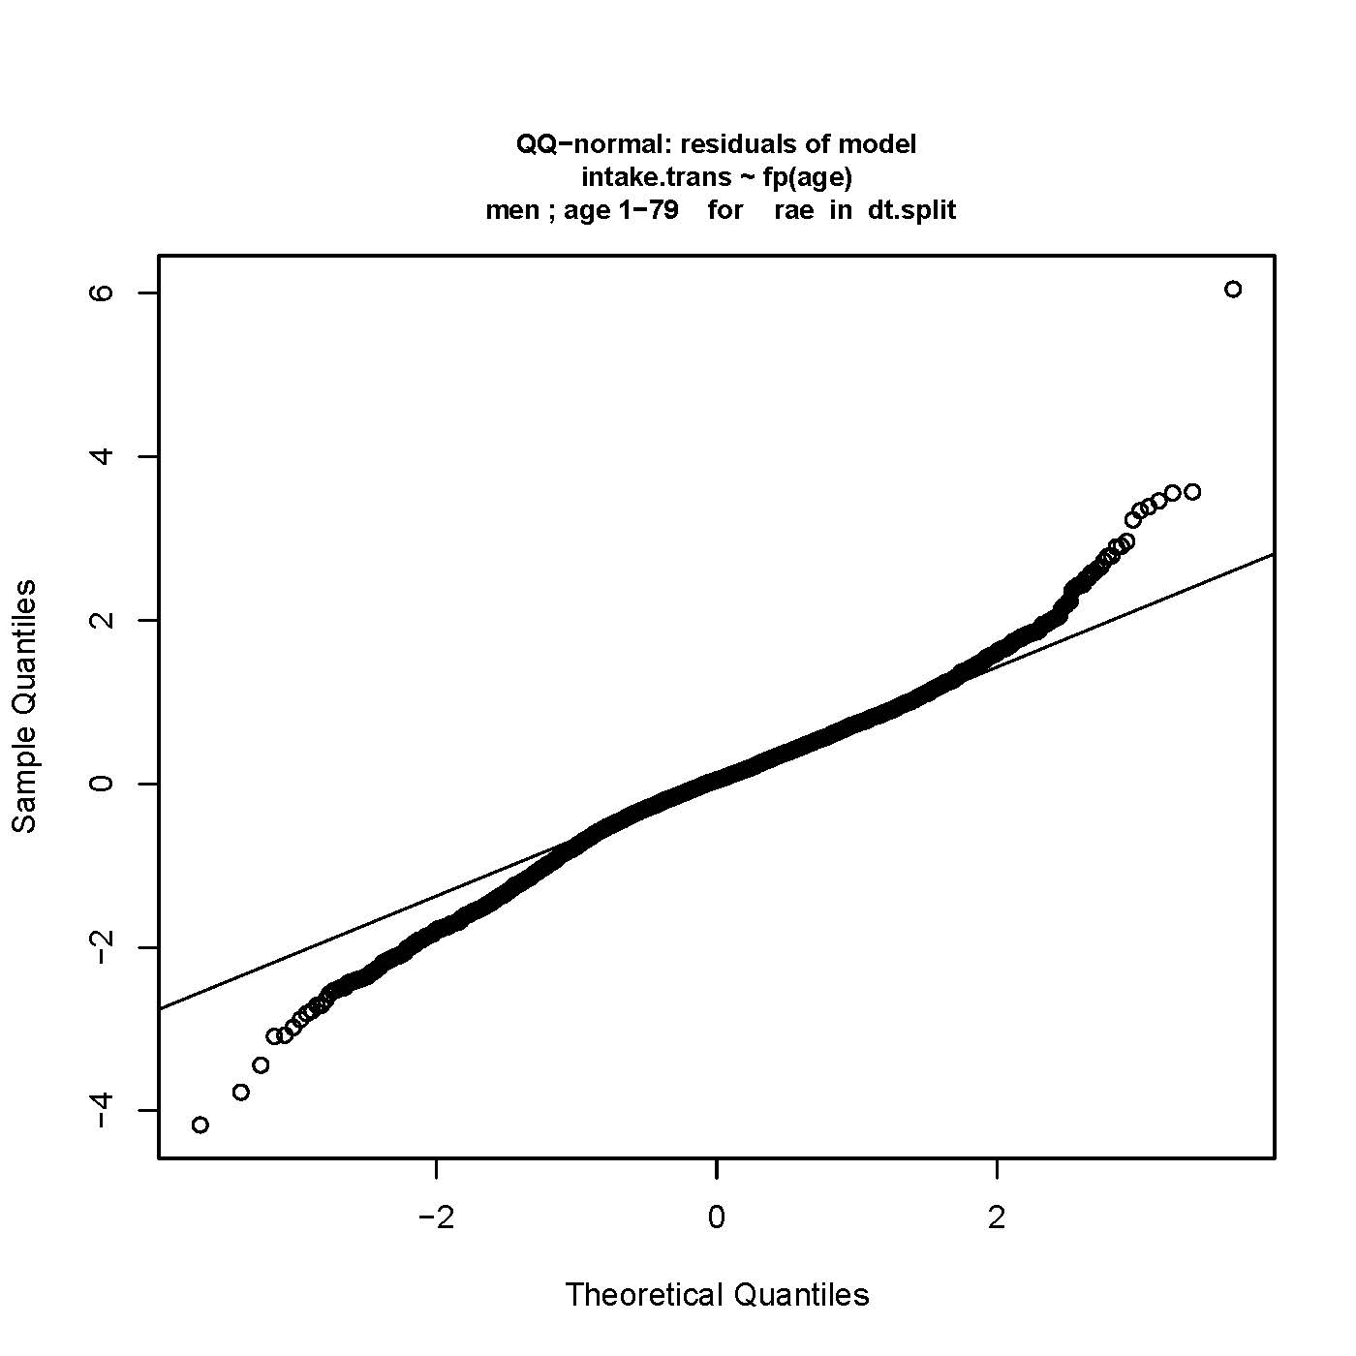
Use of 1-part model to model vitamin A intakes
1-part model: for compounds consumed on a daily basis by (virtually) everyone (e.g. vitamins and minerals)
But, 1-part model fails to meet SPADE assumptions for vitamin A
QQ plot of residuals
Model | Lambda Box-Cox transformation | Ratio within-between variance | % of difference mean (observed vs habitual)
Assumed | Between 0-1 | Between 0.25-4 | 1-part model: Between -5% – 5%
1-part model | -0.024 | 1.93 | -8.4%
Notes:
A residual is the difference between the transformed intake and the corresponding prediction of the SPADE model
The QQ-plot of the residuals of the SPADE model should theoratically be normally distributed. This is checked by this QQ-plot. Most of the residuals should be on a straight line. From this plot we conclude that the model assumptions seem to be violated, and that we cannot use the output tables. This can indicate multimodality → intake from 2 sources
A rule of thumb for lambda: 𝜆 < −0.10 means that the intake distribution is very skewed, and the user must take an extra look at the intake data
Ratio: A very high value means that the within-person variance is very high and the between-person is near to zero, indicating that there are persons with some low and some high intakes on their survey days. This causes a high contribution to the total within-person variance. On the other hand, a very low ratio means, that all persons have a low day-to-day variation and that the intakes vary a lot between the persons.
Means: These should agree since the calculation of the habitual intakes is a shrinkage method that reduces the variation in the intake distribution by eliminating the within-person variance but should not affect the mean.

Slide 7
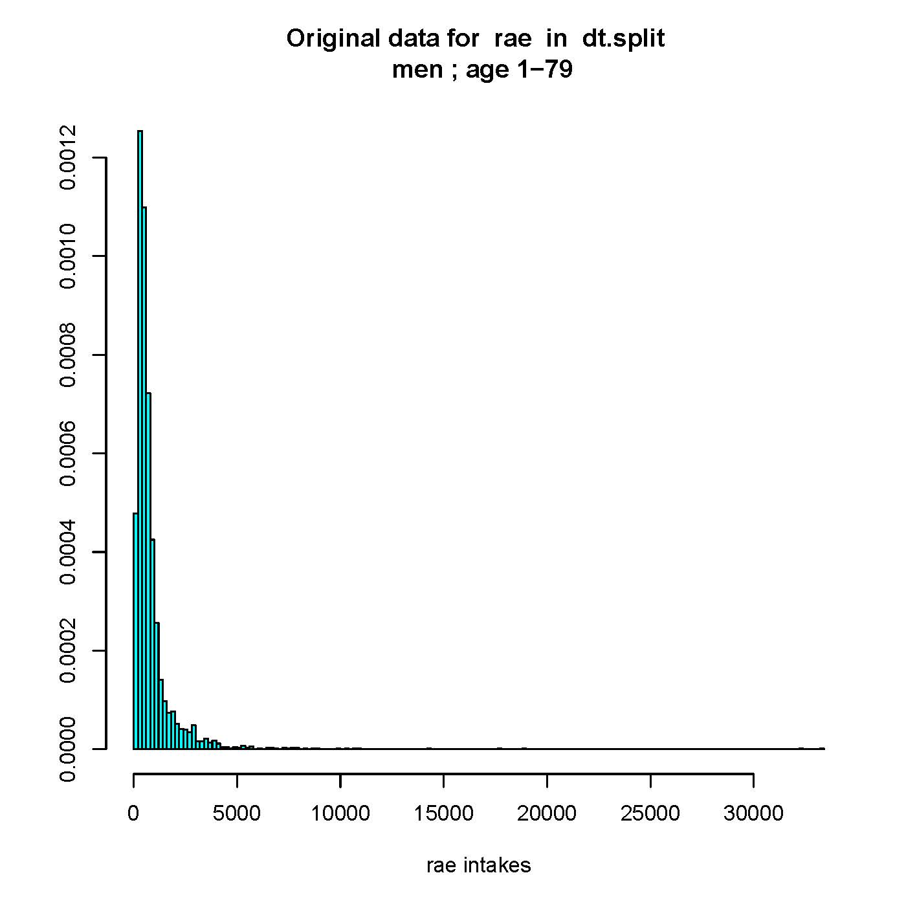
Extreme vitamin A intakes
Few users with extreme (but realistic!) vitamin A intake through liver
N ≈ 10 within Dutch National Food Consumption Surveys
Consumption on only 1 recall day
Vitamin A intake seems to have multiple sources and liver consumption seems episodical
Other models available within SPADE
2-part: for compounds consumed episodically and/or not by everyone in the population
Multipart: for intake from 2 or more sources
But, too few liver users to separately model liver intake using these models
Density
µg RAE/day

Slide 8
Objectives
To explore the optimal solution for modelling habitual A intake in the Dutch National Food Consumption Survey using SPADE
Compare the new distribution of habitual intake to the 1-part model

Slide 9
Focus: adult men within DNFCS 2012-2016
1,072 men, 18-79 y
2x 24 h recall on non-consecutive days (=2,144 recall days)
 | n | % | µg RAE/recall day (min-max)
Liver | 4 | 0.2 | 17,378-32,585
Other products | 2,144 | 100 | 17 – 3,652

Slide 10
Possible solution – multipart model
Identification of food groups rich in vitamin A foods and consumed frequently enough to be modelled separately
Rule of thumb: at least 50 persons with at least two intakes
Separately modelling of these group using multipart model
Multipart model: Intake from 2 or more sources
e.g. folate from foods and fortified foods
First-shrink-than-add approach
Separately modelling all sources using correct model (shrink part)
E.g. 1-part or 2-part model
Therafter all intakes are added for each pseuso-person (add part)

Slide 11
Possible solution – multipart model
Three sources identified within DNFCS 2012-2016:
Sources | n | % | µg RAE/recall day (min-max) | Model within multipart model
Liver, liverproducts and eel | 208 | 9.7 | 35-32,585 | 2-part model
High carrot (≥50 g/day) | 144 | 6.7 | 80-3,213 | 2-part model
Other products (including low carrot <50 g/day) | 1072 | 100 | 17-2,391 | 1-part model

Slide 12
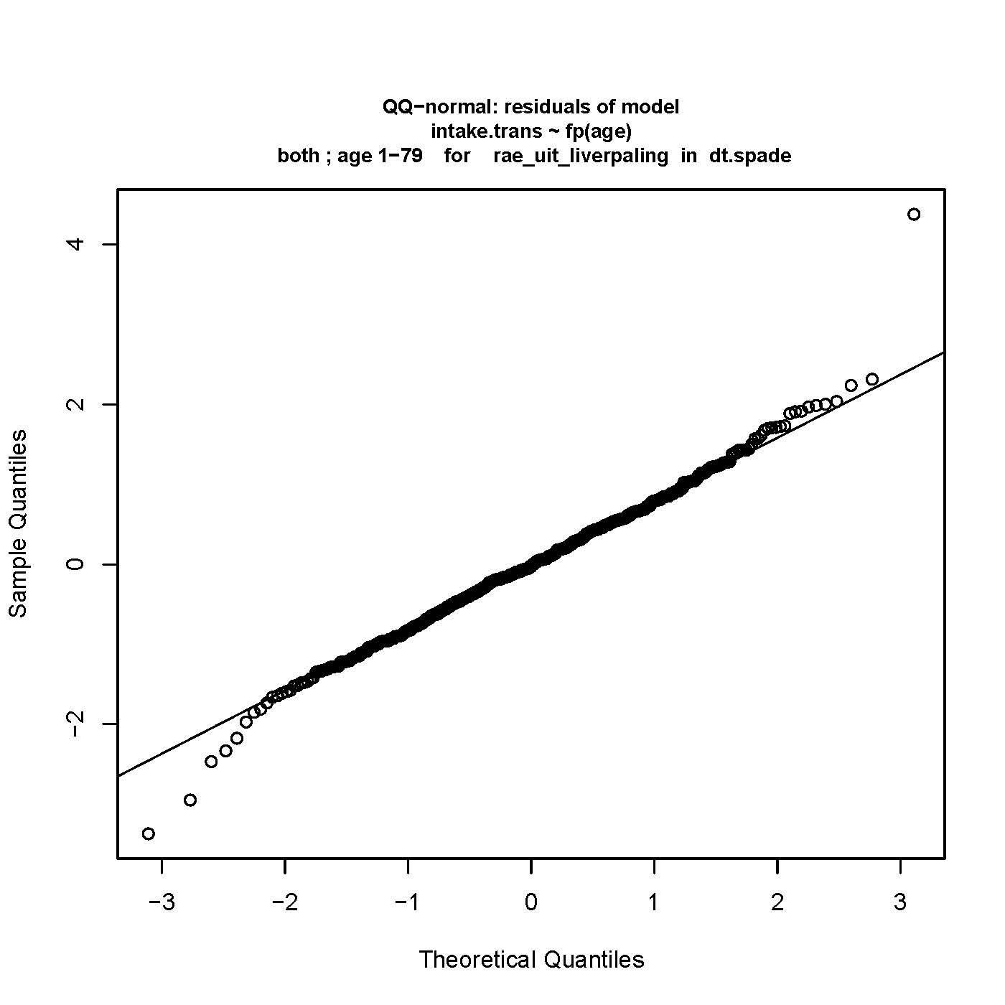
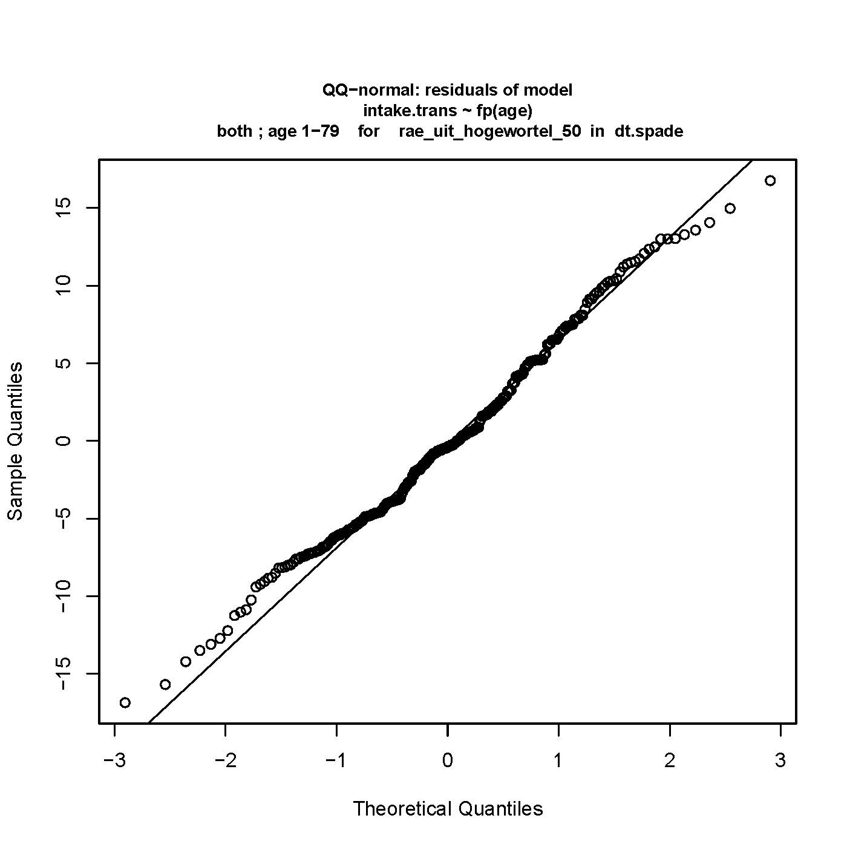
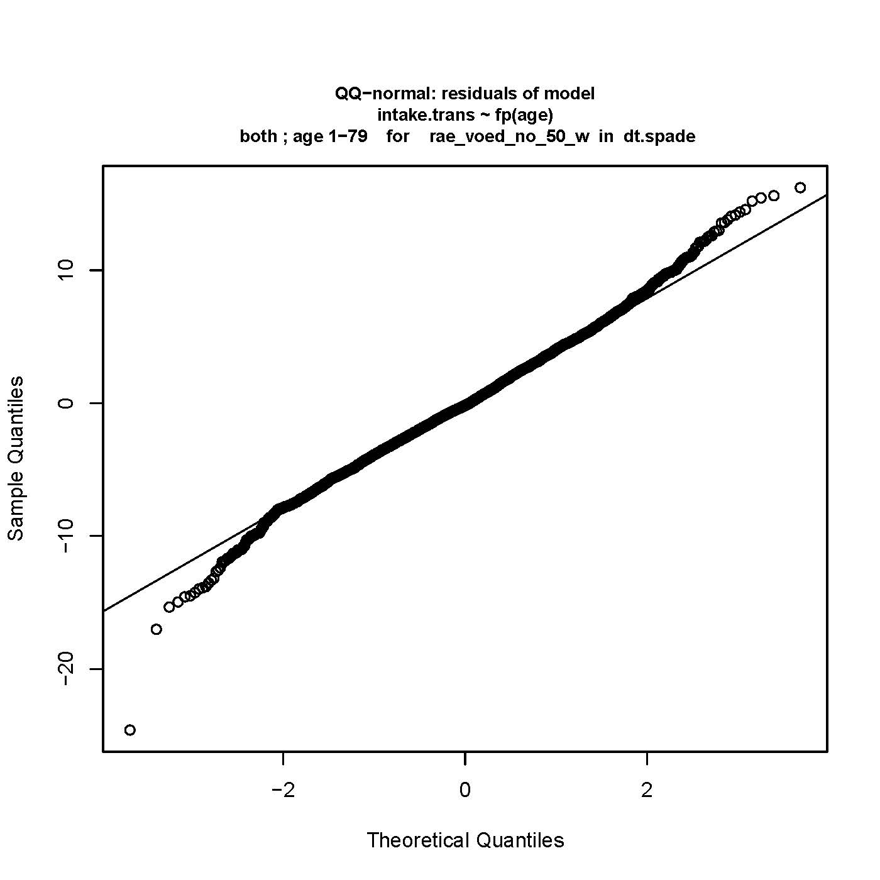
Check: Residuals of the model
1-part model
Multipart model
Liver etc
High carrot
Other products

Slide 13
Other checks
Model | Lambda Box-Cox transformation | Ratio within-between variance | % of difference mean (observed mean vs habitual mean)
Assumed
 | Between 0-1 | Between 0.25-4 | 1-part model: between -5% – 5% 2-part model: between -10% – 10%
1-part model
 | -0.024 | 1.93 | -8.4%
Multipart model
Liver etc | 0.014 | 2.4 | -5%
High carrot | 0.342 | 1.6 | -2.9%
Other | 0.324 | 0.6 | -0.4%

Slide 14
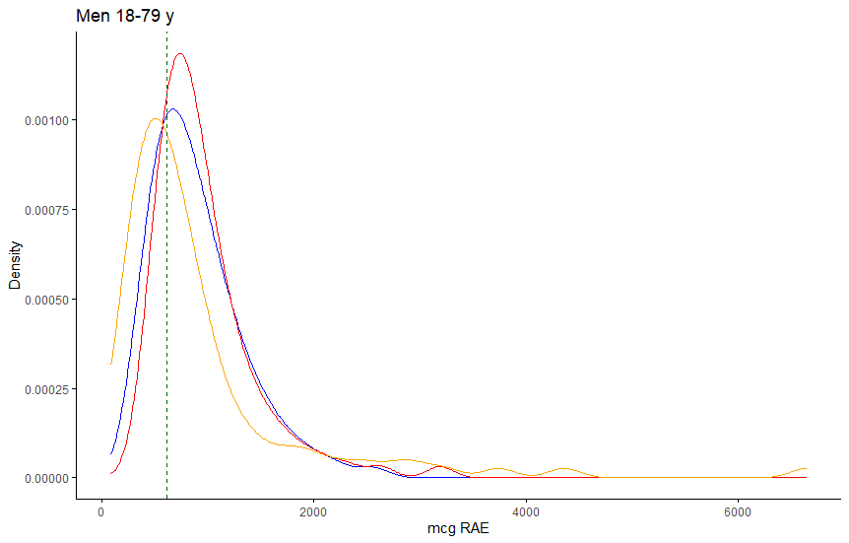
Effect on outcomes
Observed data
HI 1-part
HI Multipart
EAR=615
%<EAR:
1-part : 29%
Multipart: 20%

Slide 15
Conclusions
Separately modelling vitamin A from liver including liverproducts and eel and high carrot consumption using the multipart model seems to be an appropriate approach for habitual vitamin A intake modelling in DNFCS data
Habitual intake distribution shifts to the right when using multipart model compared to 1-part model
Can impact %<EAR or %<UL
Careful inspection of your own data is essential to select and apply the optimal model
Effects from applying the model from the current study might lead to different results when used with other data

Slide 16

Thank you!
marjolein.de.jong@rivm.nl
Co-authors:
Jeroen Rodenburg (RIVM)
Arnold Dekkers (RIVM)
Alida Melse-Boonstra (WUR)
Marianne Geleijnse (WUR)
Janneke Verkaik-Kloosterman (RIVM)

